Slide 1
SPEECH SYNTHESIS
TEAM MEMBERS
V ABHIRAM 2010030180
R VIVEK VARDHAN REDDY 2010030142
K SIDHARTH RAO 2010030443
A RAGHAVENDRA GOUD 2010030394
Mentor: Arpita Gupta

Slide 2
TABLE OF CONTENTS
PROJECT AREA
LITERATURE SURVEY
PROBLEM STATEMENT
CONCLISION
SUGGESTIONS

Slide 3
PROJECT AREA
The idea of Speech Synthesis comes under the domain of SPEECH in Artificial Intelligence.

Slide 4
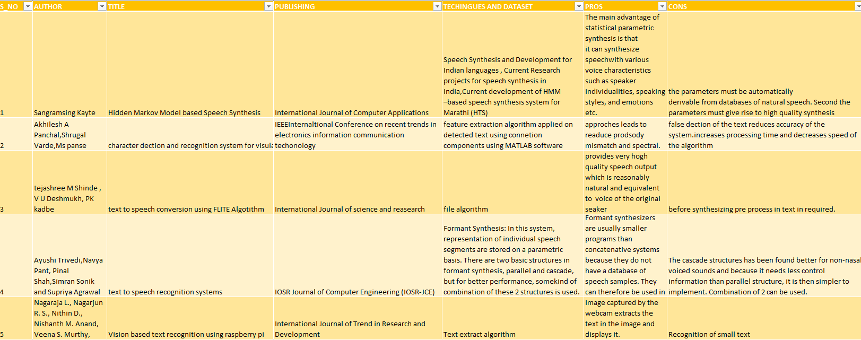
LITERATURE SURVEY

Slide 5
PROBLEM STATEMENT
The major objective of this project is to convert the given text into audio format, which will make it more comfortable for the users. This will also play an important role in replacing the Braille System, making it more easy, simple and error free for the blind.

Slide 6
CONCLUSION
With respect to the targets set by the team members, we have achieved in making

Slide 7
SUGGESTIONS
Improvement of the smoothness of the sound.
Reading of special cases like date and number.
Controlling the reading speed.
Inclusion of prosody and the naturalization of the voices like human expressions.

